Slide 1

Artistic Style Transfer
COSIMO GONNELLI, CONNOR ROBETORYE
‹#›

Slide 2
What is Artistic Style Transfer?
Process of transferring a style from a picture (style image) to another one (content image).
Use of CNN (VGG19) with which an image is represented in terms of features maps in the different layers of the network. To transfer style we want to separate content and style of image.
Extract the content: use the CNN features maps. The higher the layer the higher the loss of features. E.g. in. the last (higher layer) the feature of the general content will be kept.
‹#›

Slide 3
What is Artistic Style Transfer?
Extract the Style: we consider the style as texture. Using a deep NN texture model, look at correlation between feature responses in an image. The correlation is a value that tell us how correlated are two features in response to a particular image.
This is done for every layer creating a correlation matrices. This will give a texture model that can be used to model the style. These matrices are then used to generate a new image that reproduce correlation between feature responses in the network. This will get a texturize version of the image.
Recap: we run CNN, extract the texture from the painting, extract the content from the photograph, both in terms of features of the NN, and then generate a new image.
‹#›

Slide 4
What is Artistic Style Transfer?
Why this works?
Using higher (deeper) layers of the image we are able to maintain the structure of the image without loosing its “meaning”.
This let to perform a blending with the style where deformation occurs, but the structure of the image is maintained.
The main point is that using NN we can filter out from an image its deep semantic meaning.
‹#›

Slide 5
CNN (Convolutional Neural Network )
The CNN is a class of deep neural networks used to analyze images.
Consist of layers of small computational units that process visual information hierarchically in a feed forward manner.
Each layer of units can be understood ad a collection of image filters, each of which extract a certain feature from the input image.
The output of a given layer consists of feature maps: differently filtered versions of the input image.
‹#›

Slide 6
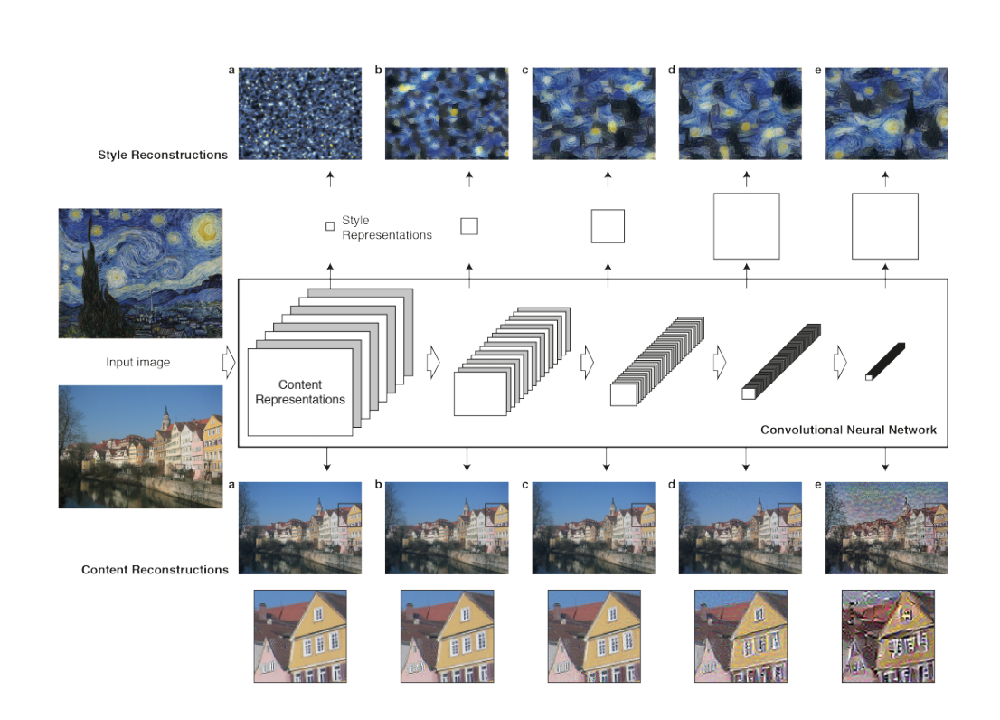
Link to paper: http://openaccess.thecvf.com/content_cvpr_2016/papers/Gatys_Image_Style_Transfer_CVPR_2016_paper.pdf
‹#›

Slide 7
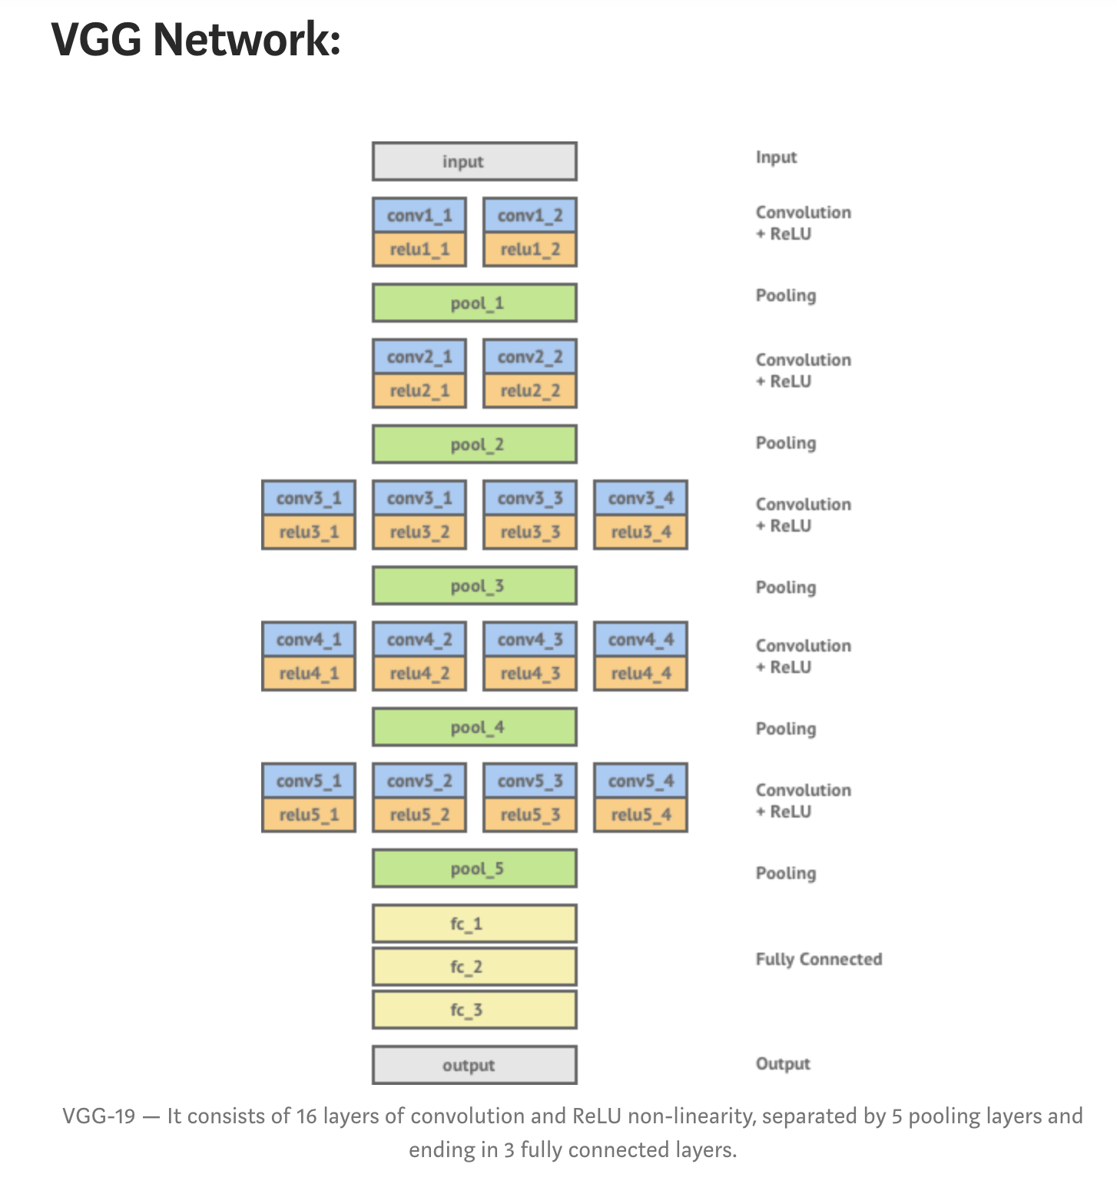
VGG19 (Visual Geometry Group 19)
NOTE: “Pooling layers provide an approach to down sampling feature maps by summarizing the presence of features in patches of the feature map.” Done to address the problem of the output feature maps that are sensitive to the location of the feature in the input.
Source Image: https://medium.com/data-science-group-iitr/artistic-style-transfer-with-convolutional-neural-network-7ce2476039fd
‹#›

Slide 8
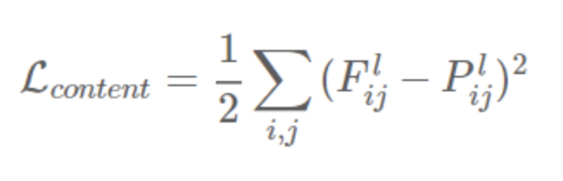
Content Loss
Given a chosen content layer l, the content loss is defined as the Mean Squared Error between the feature map F of our content image C and the feature map P of our generated image Y. When this content-loss is minimized, it means that the mixed-image has feature activation in the given layers that are very similar to the activation of the content-image. Depending on which layers we select, this should transfer the contours from the content-image to the mixed-image.
‹#›

Slide 9
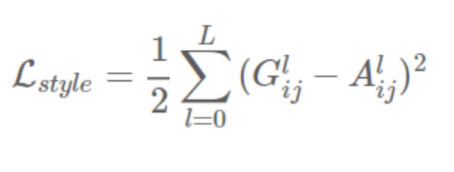
Style Loss
The loss function for style is quite similar to content loss, except that we calculate the Mean Squared Error for the Gram-matrices instead of the raw tensor-outputs from the layers.
As with the content representation, if we had two images whose feature maps at a given layer produced the same Gram matrix we would expect both images to have the same style, but not necessarily the same content.
‹#›

Slide 10
PLAN
Aspiration: Train a ML artistic model using different styles and algorithms
Investigate how image size affects run time, memory use and performance (loss):
ADAM vs L-BFGS
Investigate the effects of varying image content or style.
Compare results of the two algorithms
‹#›

Slide 11
TECHNOLOGIES
Software Platform: Python (3.7.5 x64)
Training: TensorFlow (1.15.1)
Neural Network model:
CNN (VGG19)
Algorithms for optimizing loss:
ADAM
L-BFGS
‹#›

Slide 12
ADAM(Adaptive Moment Estimation)
Combination of gradient discent with momentum and RMSprop algorithm.
Steps:
It calculates an exponentially weighted average of past gradients and stores it in different variables before bias correction and after bias correction.
It calculates an exponentially weighted average of the squares of the past gradient and stores it in different variables again before and after the bias correction.
Updates parameters in a direction based on combining information from 1 and 2
‹#›

Slide 13
L-BFGS (L-Broyden Fletcher Goldfarb Shanno)
Limited-memory BFGS is an optimization algorithm in the family of quasi-Newton methods that approximates the (BFGS).
Steps:
It approximates the objective function with a locally quadratic optimization.
It use a quasi-Newton method to updates the weight: it use an approximate Hessian matrix and the calculated gradient to get a direction in which to update its weight.
Hessian estimation refined over time by saving successive approximations
‹#›

Slide 14


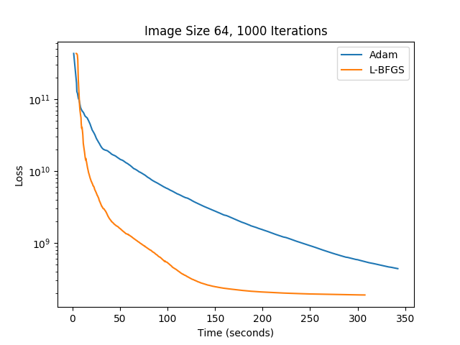

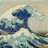
RESULTS (64x64)
ADAM
L-BFGS
‹#›

Slide 15
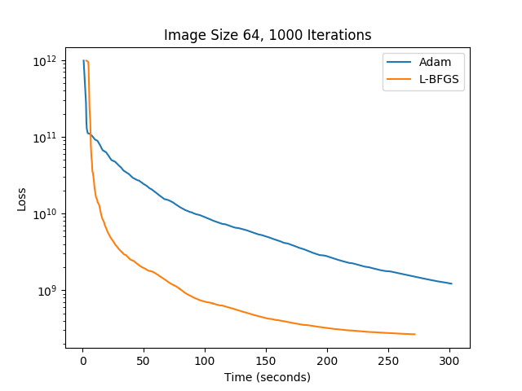
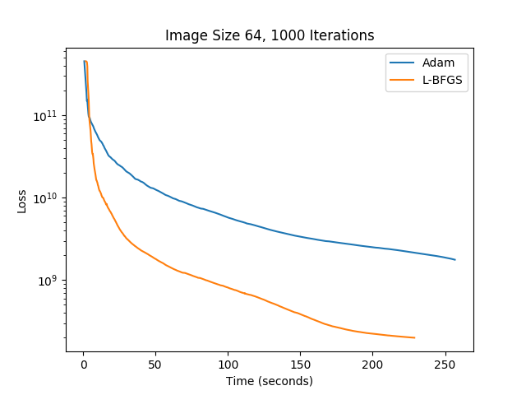


RESULTS (64x64)
‹#›

Slide 16
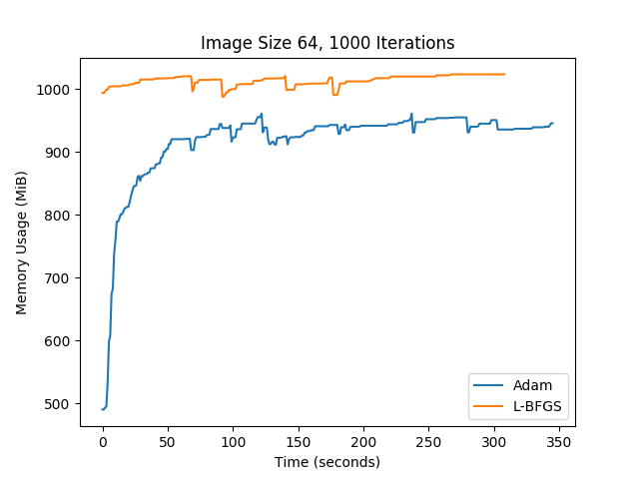
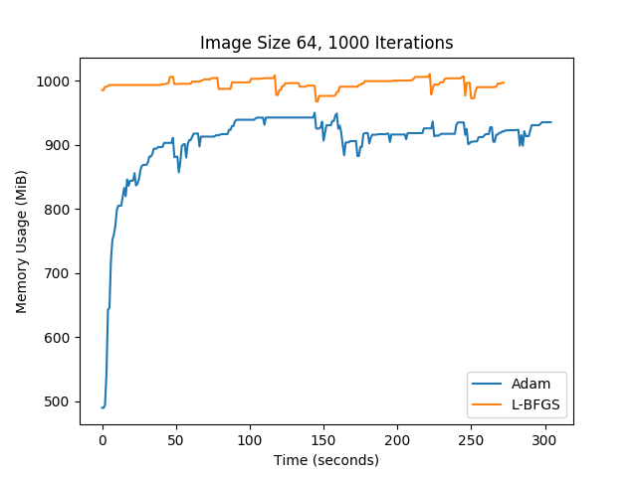
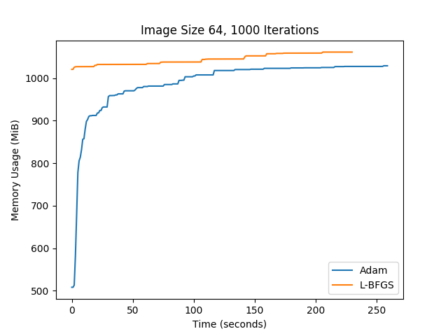
RESULTS (64x64)
‹#›

Slide 17
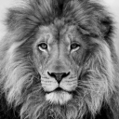
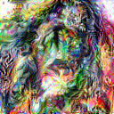
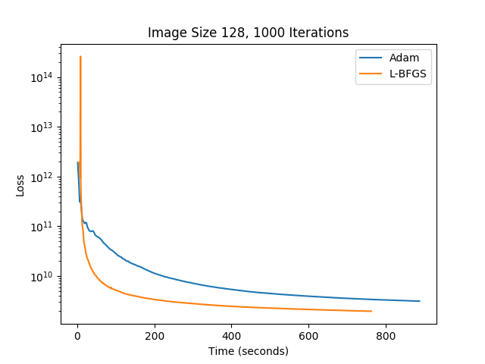

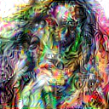
RESULTS (128x128)
ADAM
L-BFGS
‹#›

Slide 18
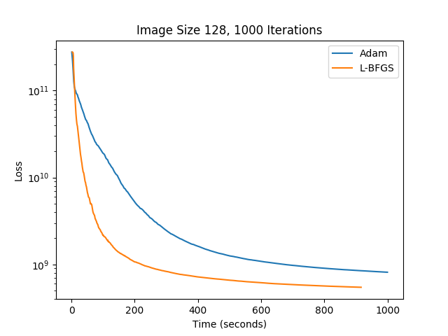
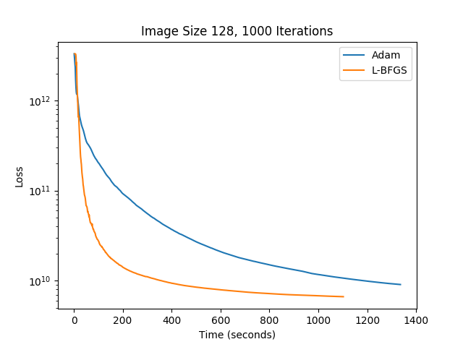

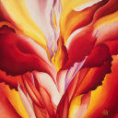
RESULTS (128x128)
‹#›

Slide 19
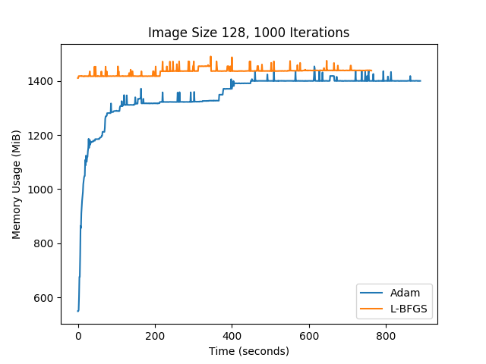
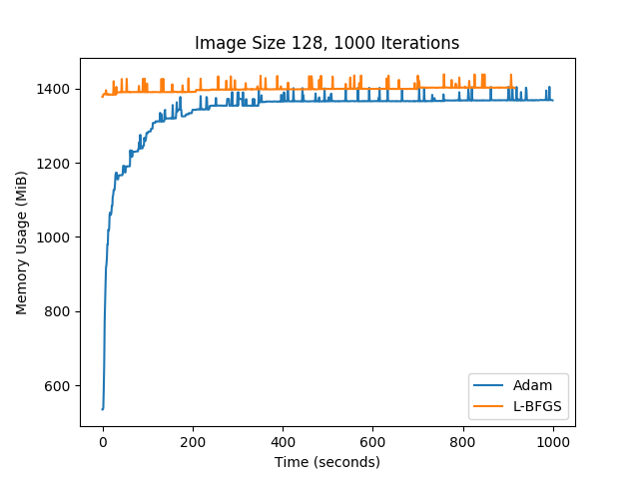
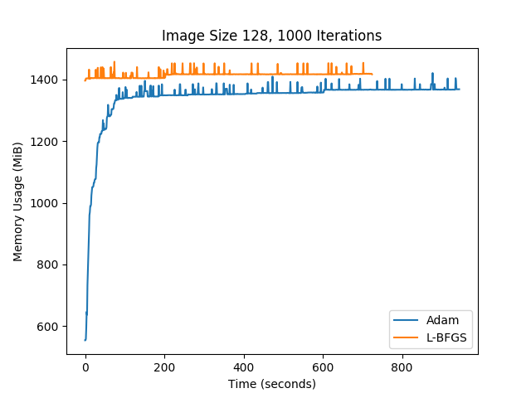
RESULTS (128x128)
‹#›

Slide 20

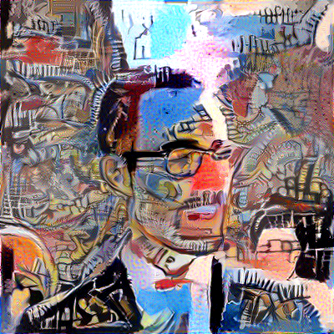
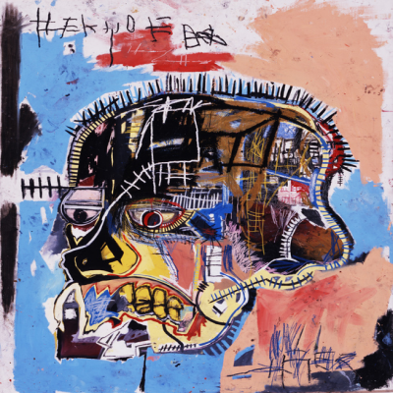
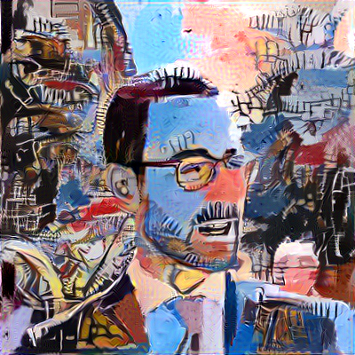
RESULTS (512x512)
ADAM
L-BFGS
‹#›

Slide 21
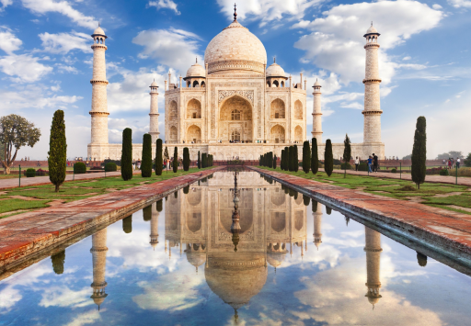
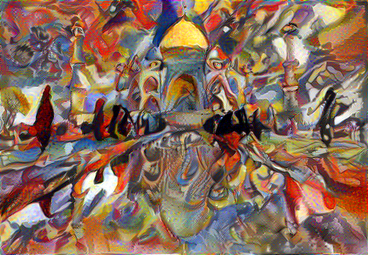
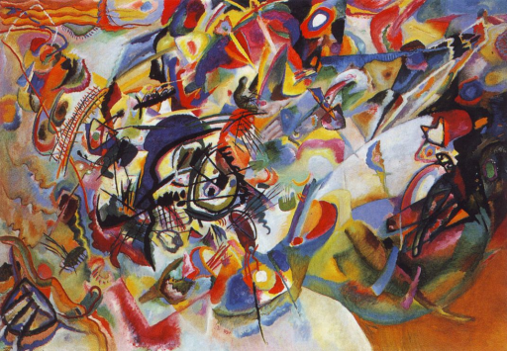
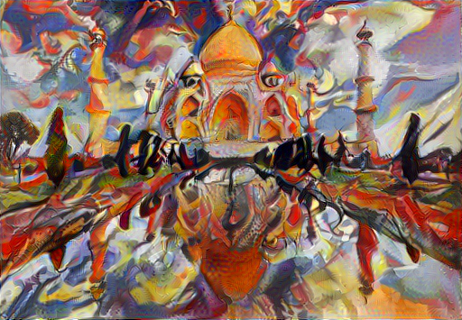
RESULTS (512x512)
Adam
LBFGS
‹#›

Slide 22

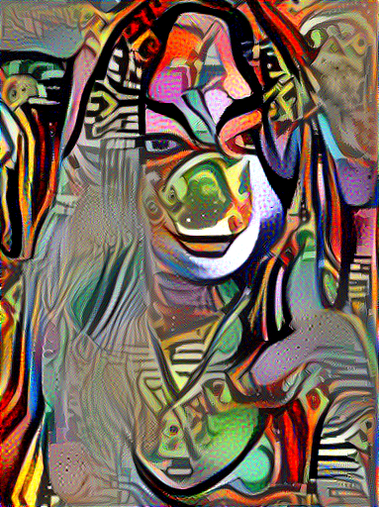
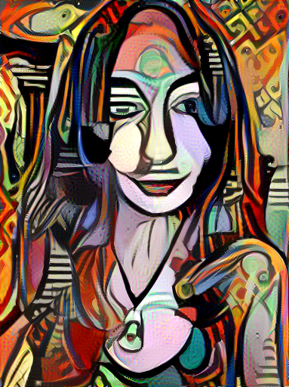
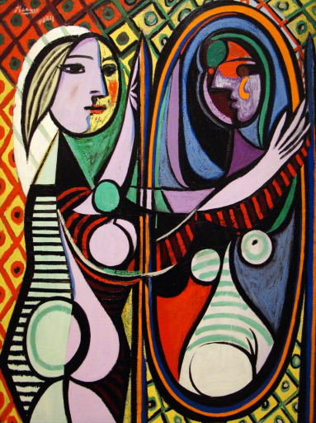
RESULTS (512x512)
Adam
LBFGS
‹#›

Slide 23
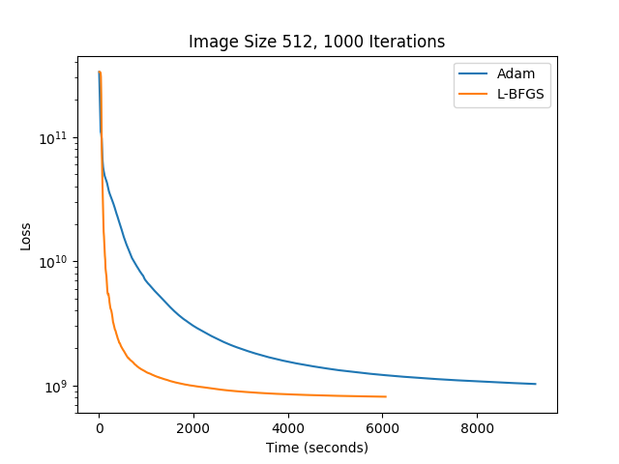
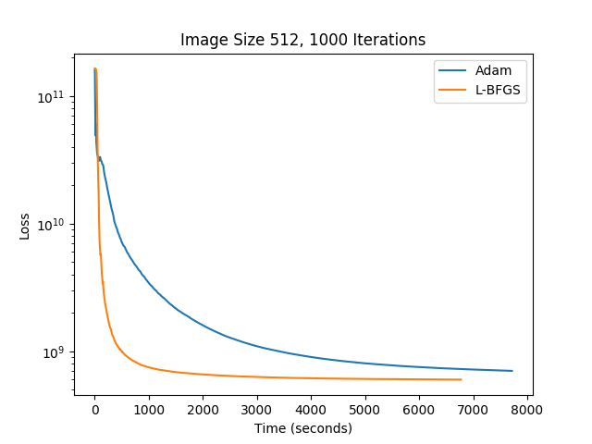
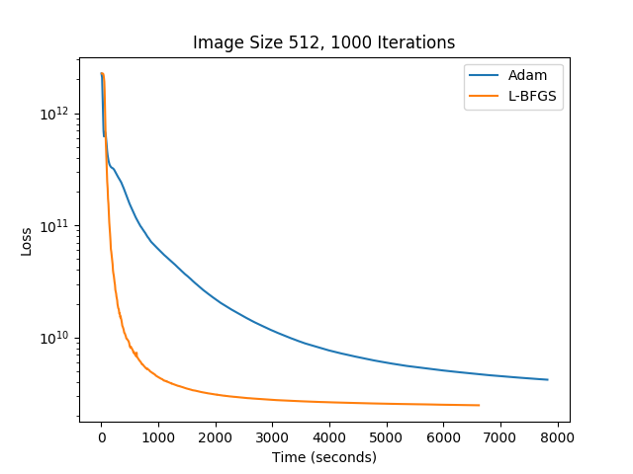
RESULTS (512x512)
‹#›

Slide 24
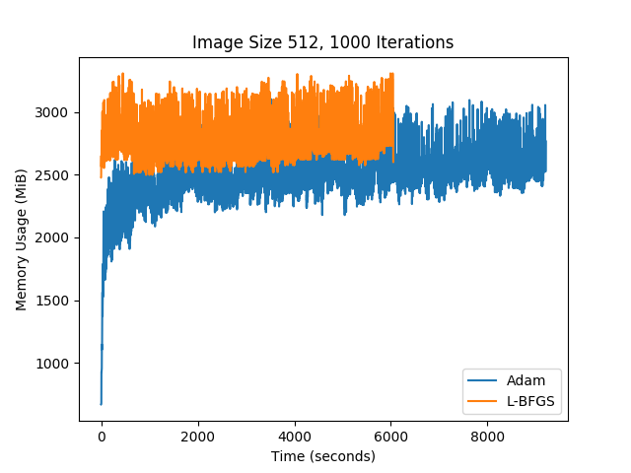
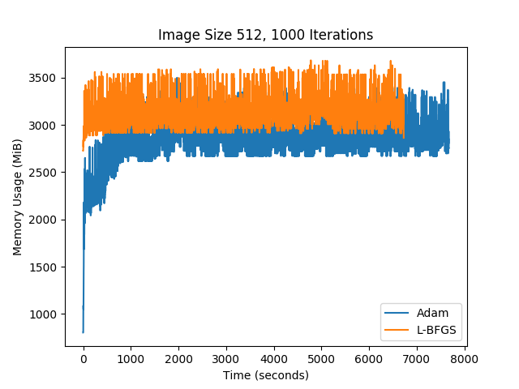
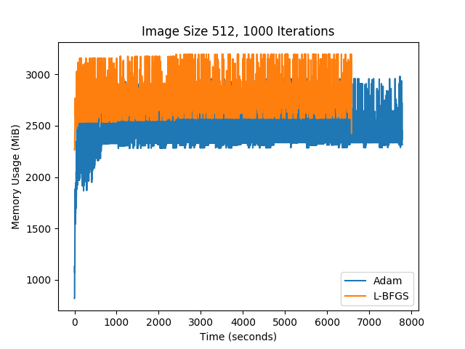
RESULTS (512x512)
‹#›

Slide 25
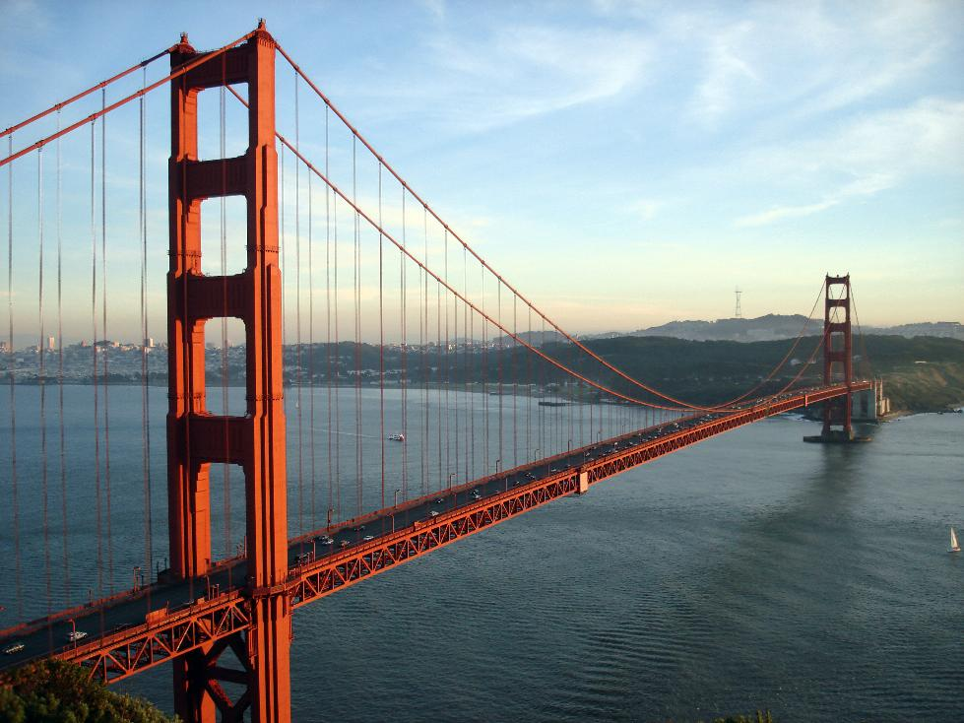
RESULTS (1024x1024)
‹#›

Slide 26
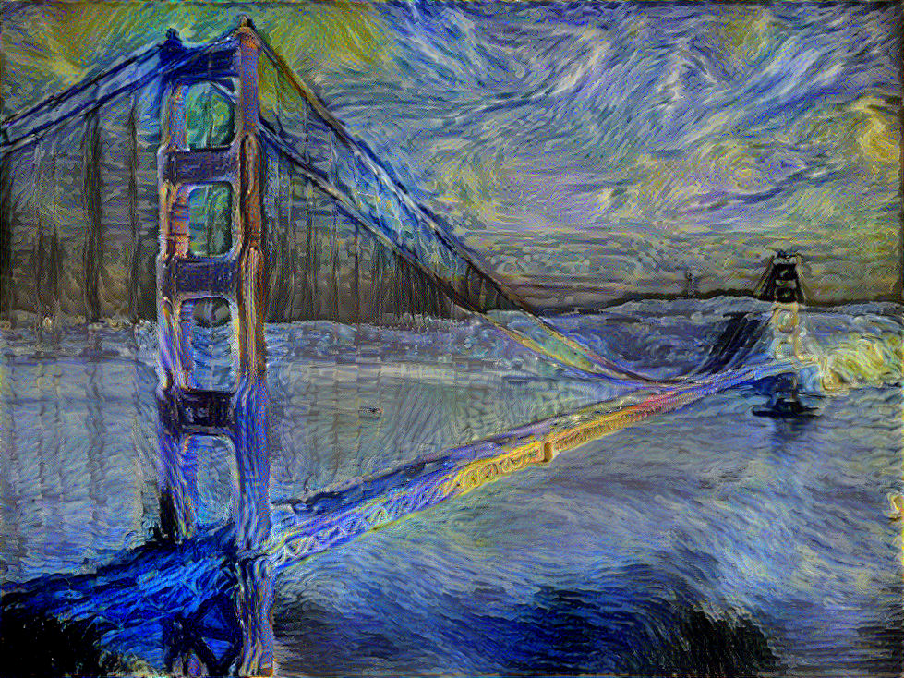
RESULTS (1024x1024)
ADAM
‹#›

Slide 27
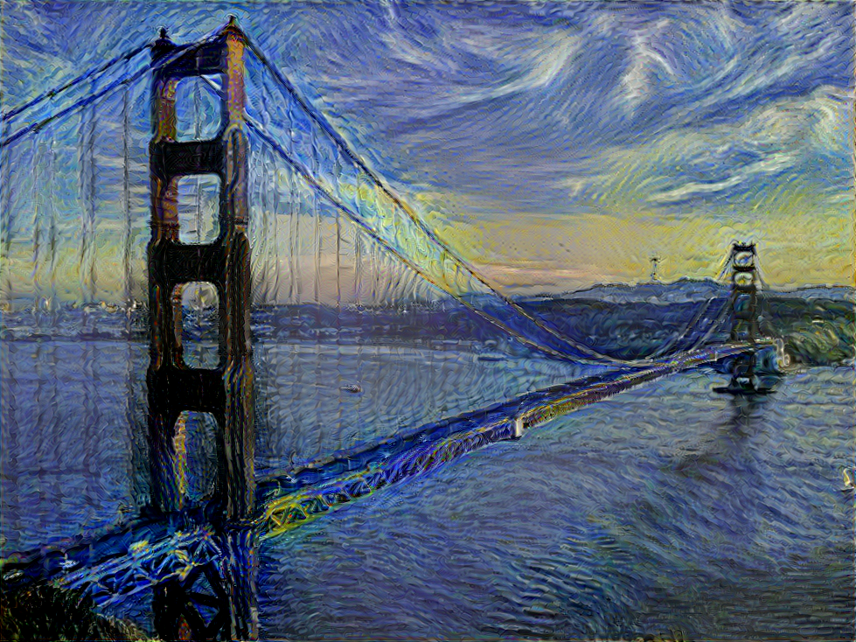
RESULTS (1024x1024)
L-BFGS
‹#›

Slide 28

RESULTS (1024x1024)
‹#›

Slide 29
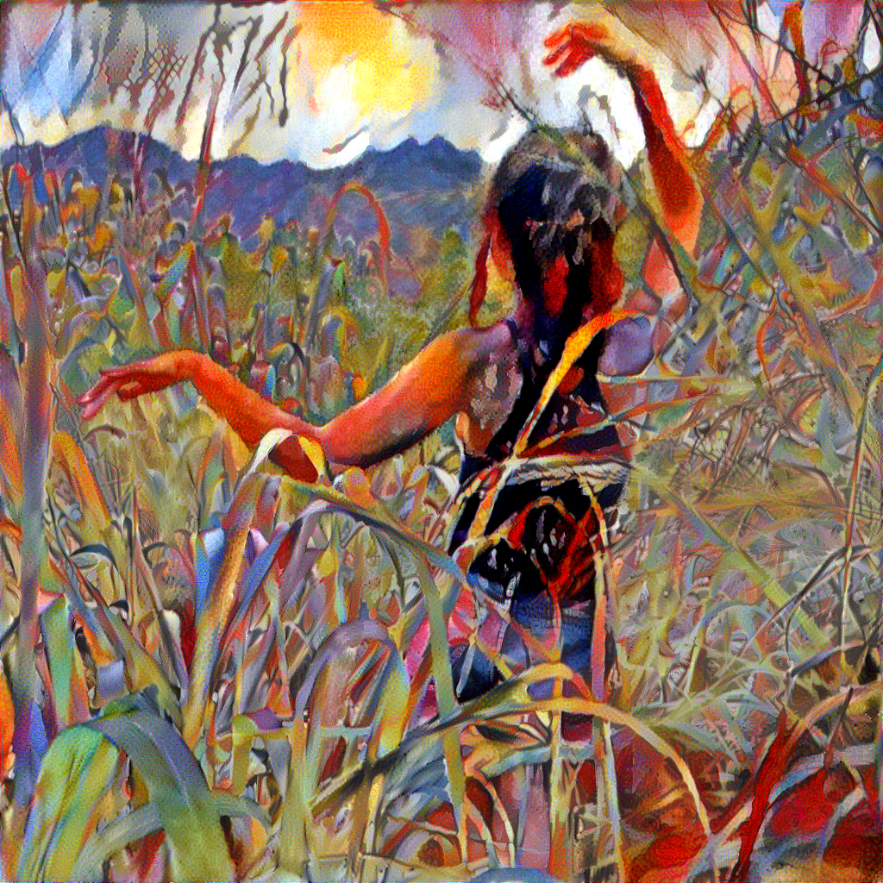
RESULTS (1024x1024)
ADAM
‹#›

Slide 30
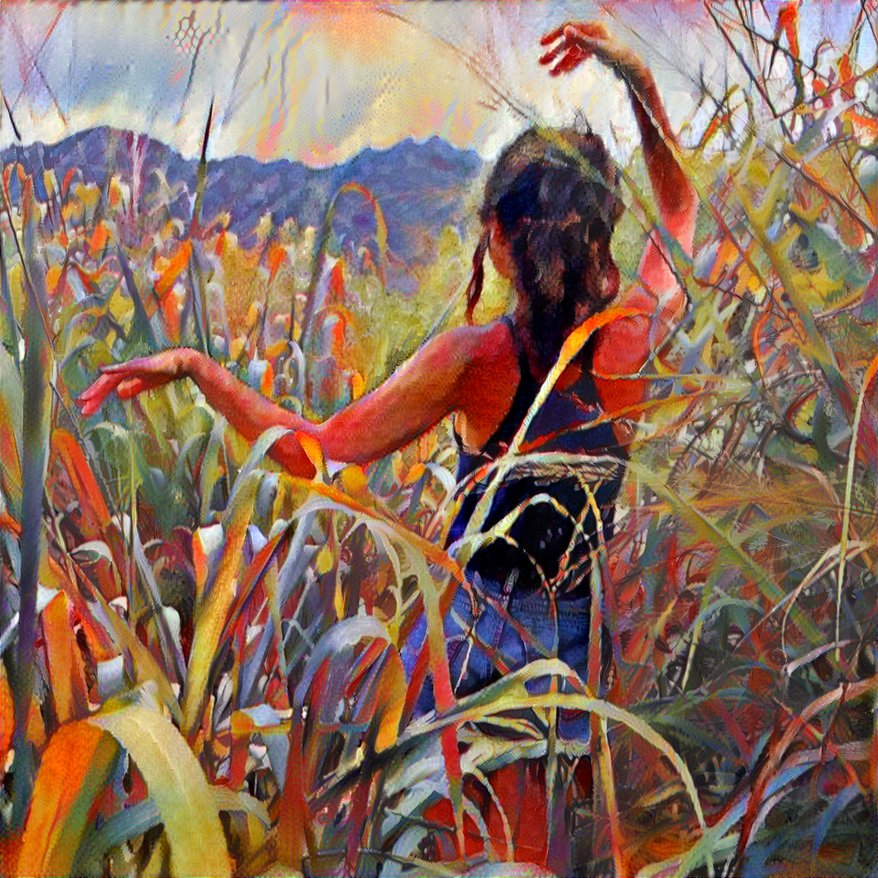
RESULTS (1024x1024)
L-BFGS
‹#›

Slide 31
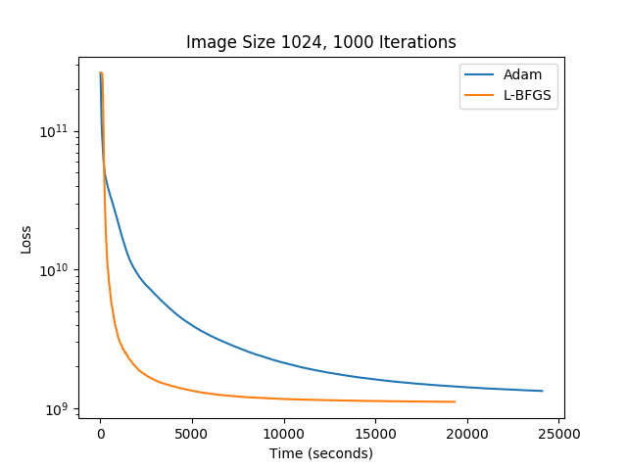
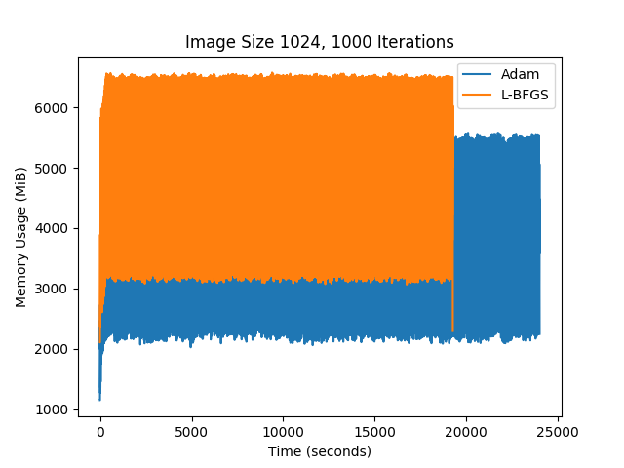
RESULTS (1024x1024)
‹#›

Slide 32
COMPARATIVE RESULTS
LBFGS is favored over Adam in terms of loss and compute time
Adam is favored for memory usage, especially as image size grows
Increasing image size does not effect the relative advantages of our respective loss optimization algorithms with respect to performance and memory usage
Choice of size-controlled content image does not affect time or memory usage
Choice of style image does disproprotionately affect LBFGS time
‹#›

Slide 33
COMPARATIVE RESULTS
Prefer Adam when memory is limited, but time is unconstrained, and tuning hyperparameters for moment estimation, learning rate not a problem, especially for large images
Prefer LBFGS when image quality is the priority, memory usage is not a limiting factor
Adam has special use case in tensorflow implementation with recording intermediary outputs
‹#›

Slide 34
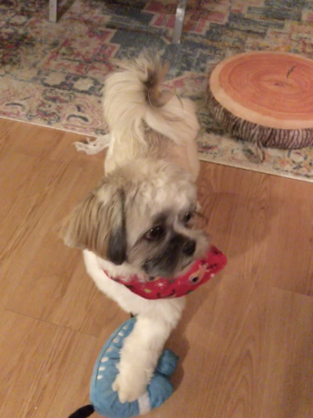

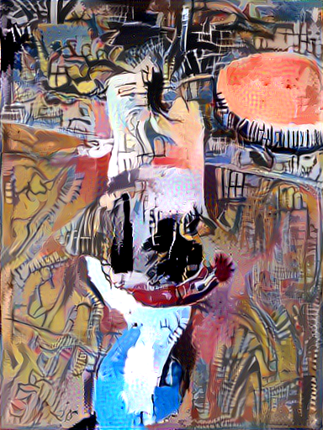
BONUS DOGS (512x512)
‹#›

Slide 35
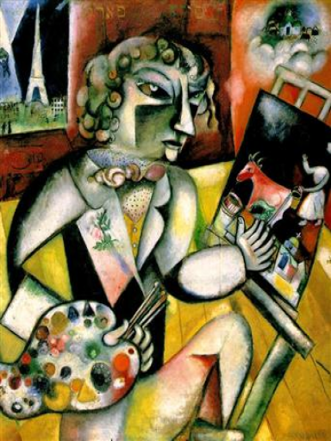
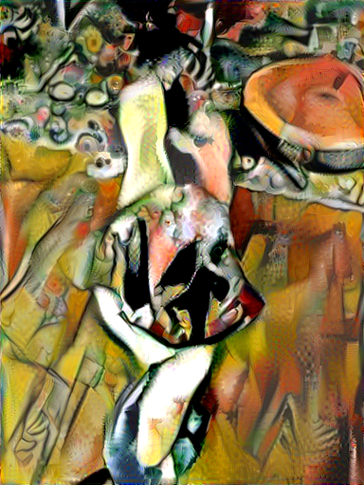
BONUS DOGS (512x512)
‹#›

Slide 36
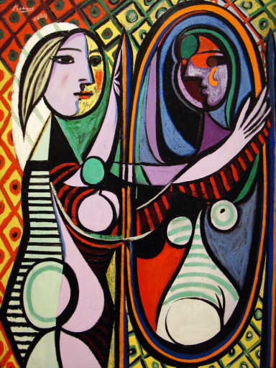
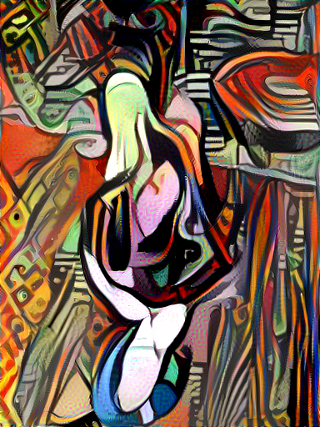
BONUS DOGS (512x512)
‹#›

Slide 37


BONUS DOGS (512x512)
‹#›

Slide 38


BONUS DOGS (512x512)
‹#›

Slide 39
Resources
C. Zhu, R. H. Byrd, P. Lu, and J. Nocedal. Algorithm 778: L-BFGS-B: Fortran subroutines for large-scale boundconstrained optimization. ACM Transactions on Mathematical Software (TOMS), 23(4):550–560, 1997.
A Neural Algorithm of Artistic Style
Image Style Transfer Using Convolutional Neural Networks
Artistic Style Transfer with Convolutional Neural Network
ADAM: https://arxiv.org/pdf/1412.6980.pdf
L-BFGS: http://curtis.ml.cmu.edu/w/courses/index.php/L-BFGS
‹#›

